Slide 1


TRENDS IN SUSTAINABLE FASHION & ITS CONSUMER APPEAL
ARUNIMA K
DA/DS
MILSTONE-1
18-12-2024

Slide 2


INTR0DUCTION
This analysis aims to explore trends in sustainable fashion and consumer appeal, providing insights to drive sustainable practices and inform industry strategies.

Slide 3

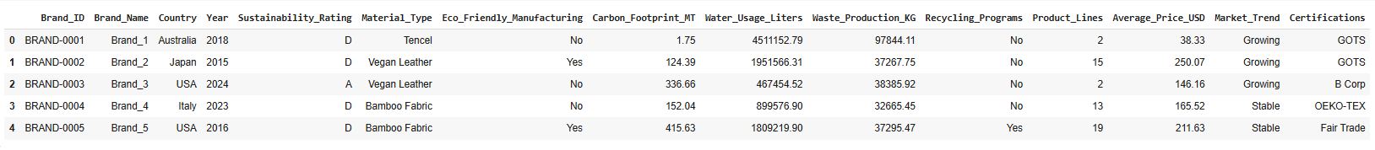
DATA UNDERSTANDING
No:of Rows :5000
No:of Columns:15

Slide 4
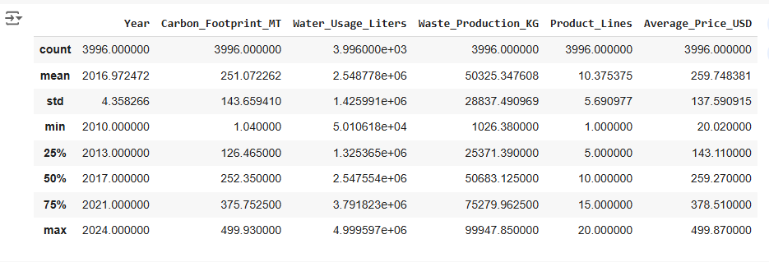
Summary Statistics

Slide 5

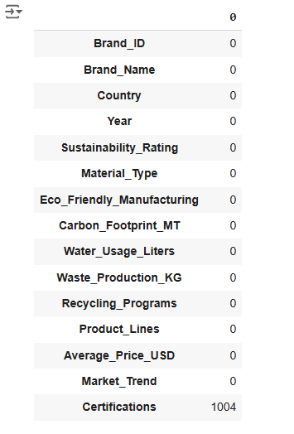
Missing Values

Slide 6
Missing Values Handling

Slide 7

Shape of Dataset
shape | Before | After
No:of Rows | 5000 | 3996
No:of Columns | 15 | 15

Slide 8
Data Visualization
Bar Chart
Histogram
Scatterplot
pair plot

Slide 9
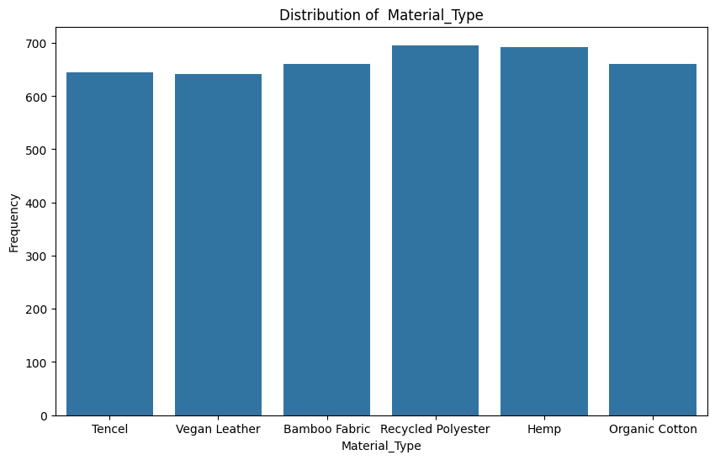
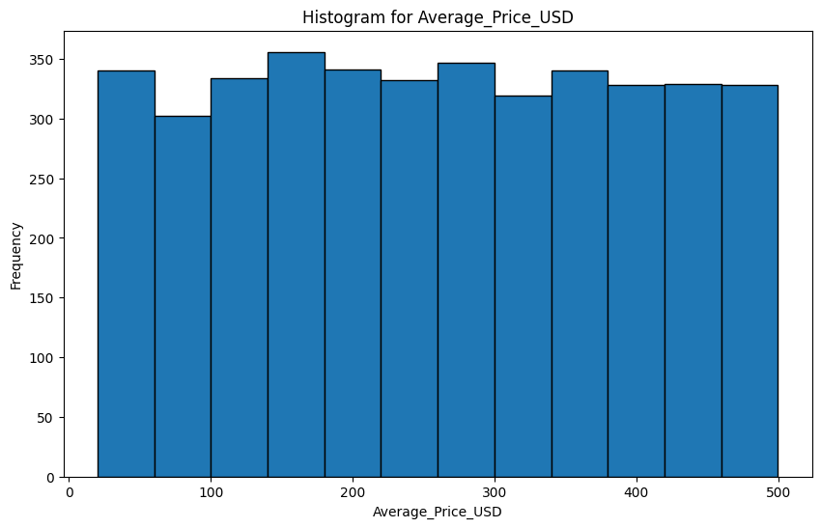
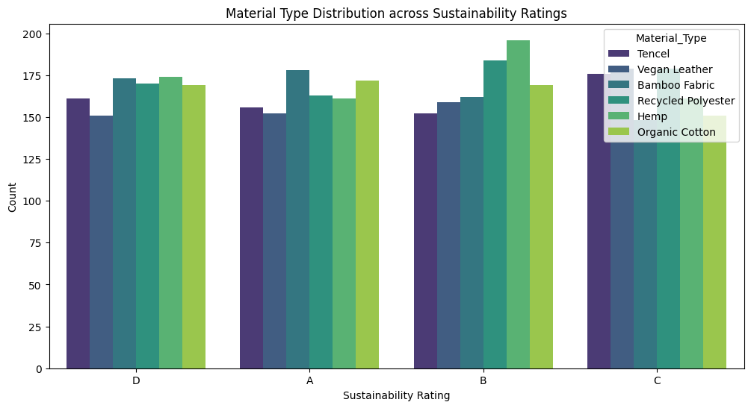

Slide 10
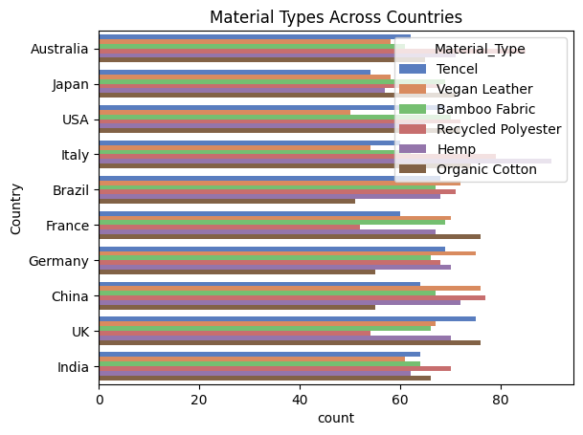
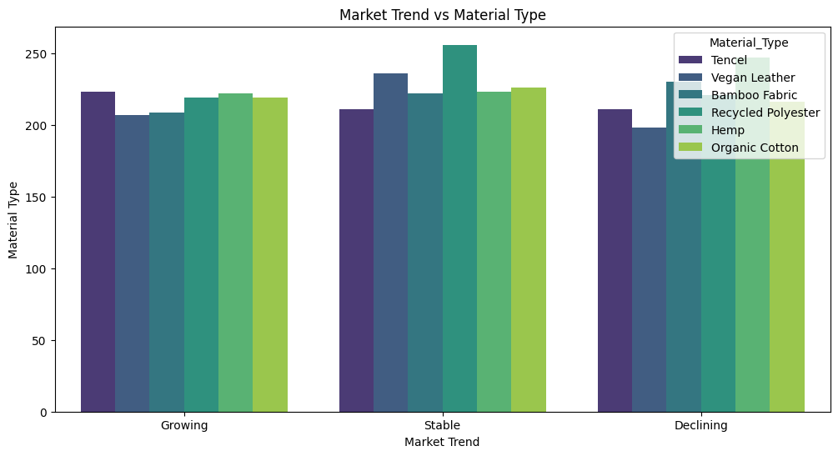
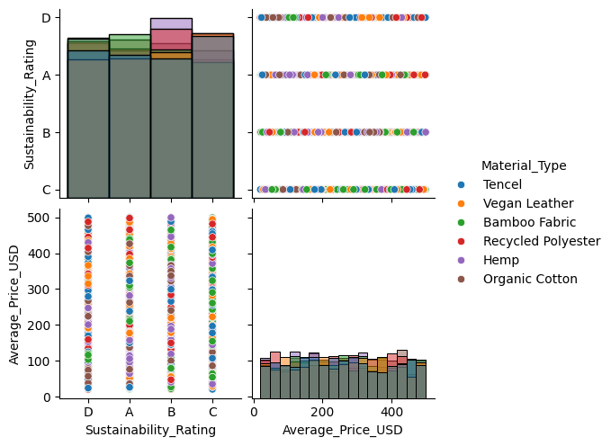

Slide 11
Hypothesis Testing
Two-Sample Independent T-test
Analysis of Variance (ANOVA)
One-Way ANOVA

Slide 12
Two-Sample Independent T-test
objective :
To test if there is a any significant difference in the average prices (USD) between two material types:
Recycled Polyester and Tencel.

Slide 13
Independent Observation

Slide 14
Shapiro-Wilk Test for Normality
Levene's Test for Equal Variance

Slide 15
Independent t test
Mann-Whitney U Test (Non-Parametric Test)

Slide 16
One-Way ANOVA
objective :
To test if there is a significant difference in the average price of products based on their sustainability
sustainability ratings (A, B, C, D).

Slide 17
Shapiro-Wilk Test for Normality
Levene's Test for Equal Variance

Slide 18
One-Way ANOVA Test
Kruskal-Wallis Test

Slide 19

Conclusion
Sustainable materials like Tencel and Organic Cotton highlight trends in sustainable fashion by being affordable and highly rated, making eco-friendly options appealing to consumers.

Slide 20
Thank You

